Slide 1
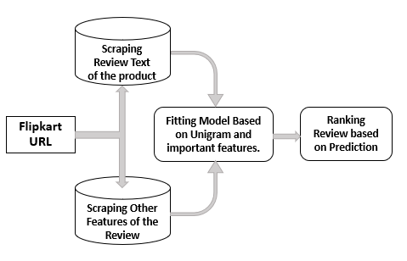
Process Flow
Scraping Review Text of the product
Fitting Model Based on Unigram and important features.
Ranking Review based on Prediction
Flipkart URL
Scraping Other Features of the Review
* Limited to Products on Flipkart

